Slide 1
Creating a VMIS account
Note: The approving authority for Fort Huachuca isn’t going to be the approving authority when you PCS (New installation)

Slide 2
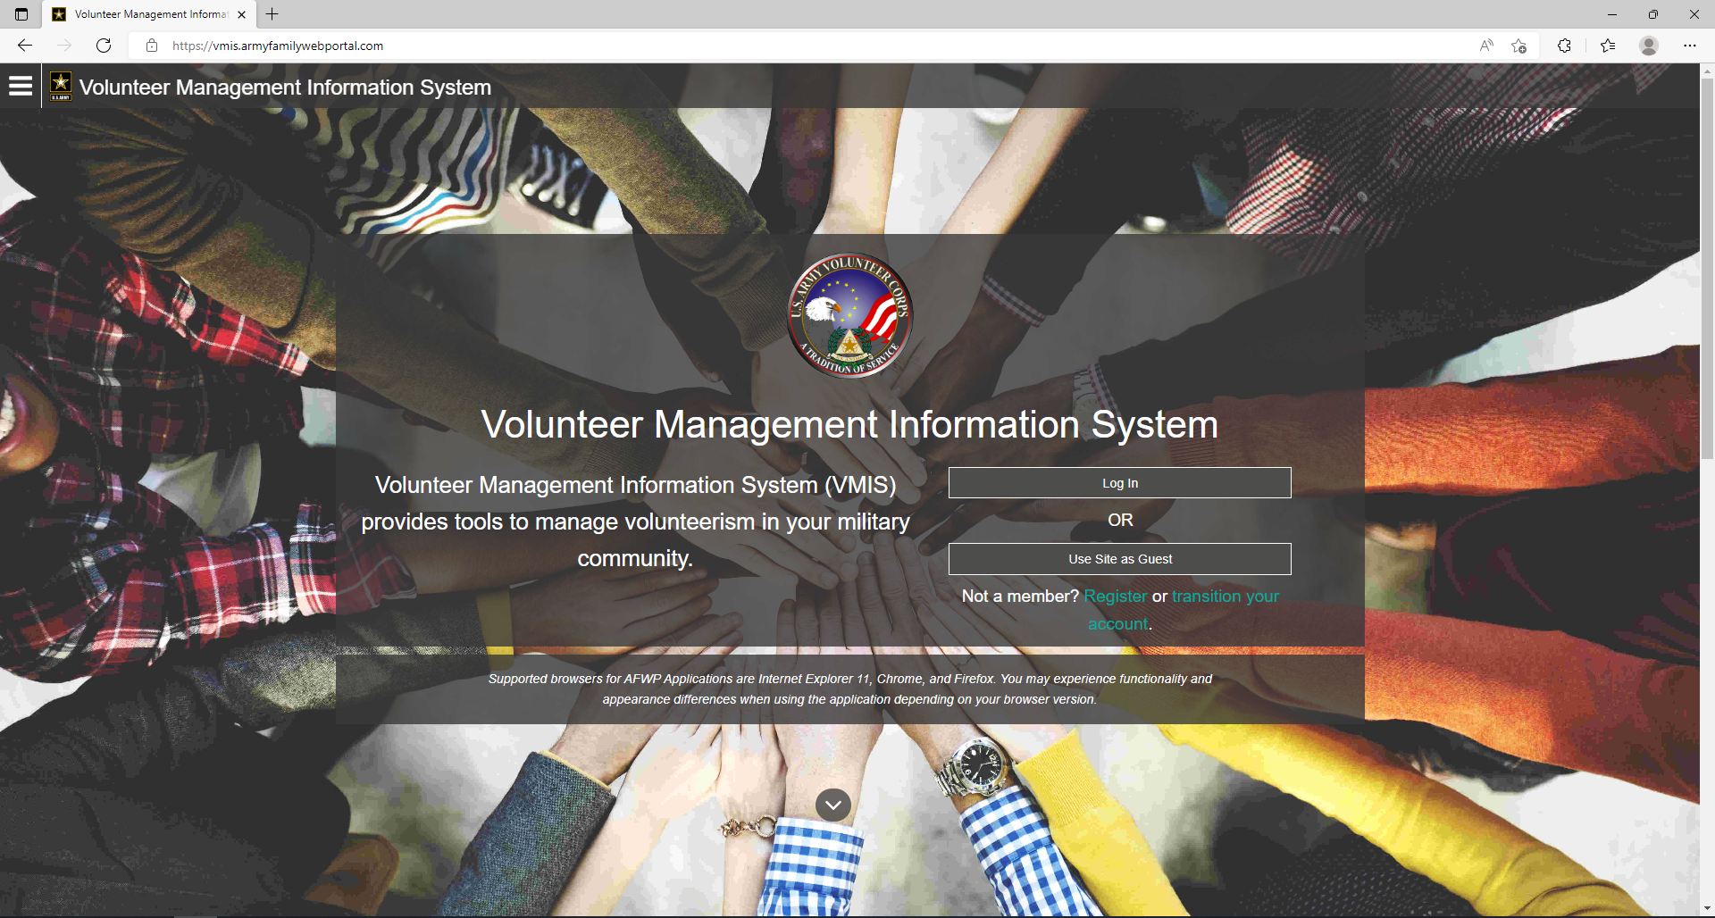
Step 1: Go to this webpage

Slide 3
Step 2: Pick Log In

Slide 4
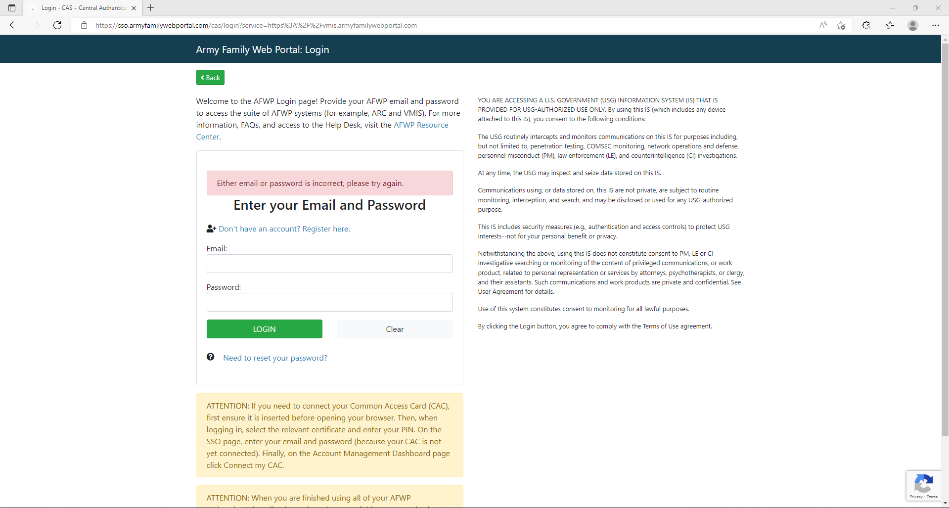
Step 3: You will be routed to this screen

Slide 5
Step 4: Click “Don’t have an account? Register here”

Slide 6
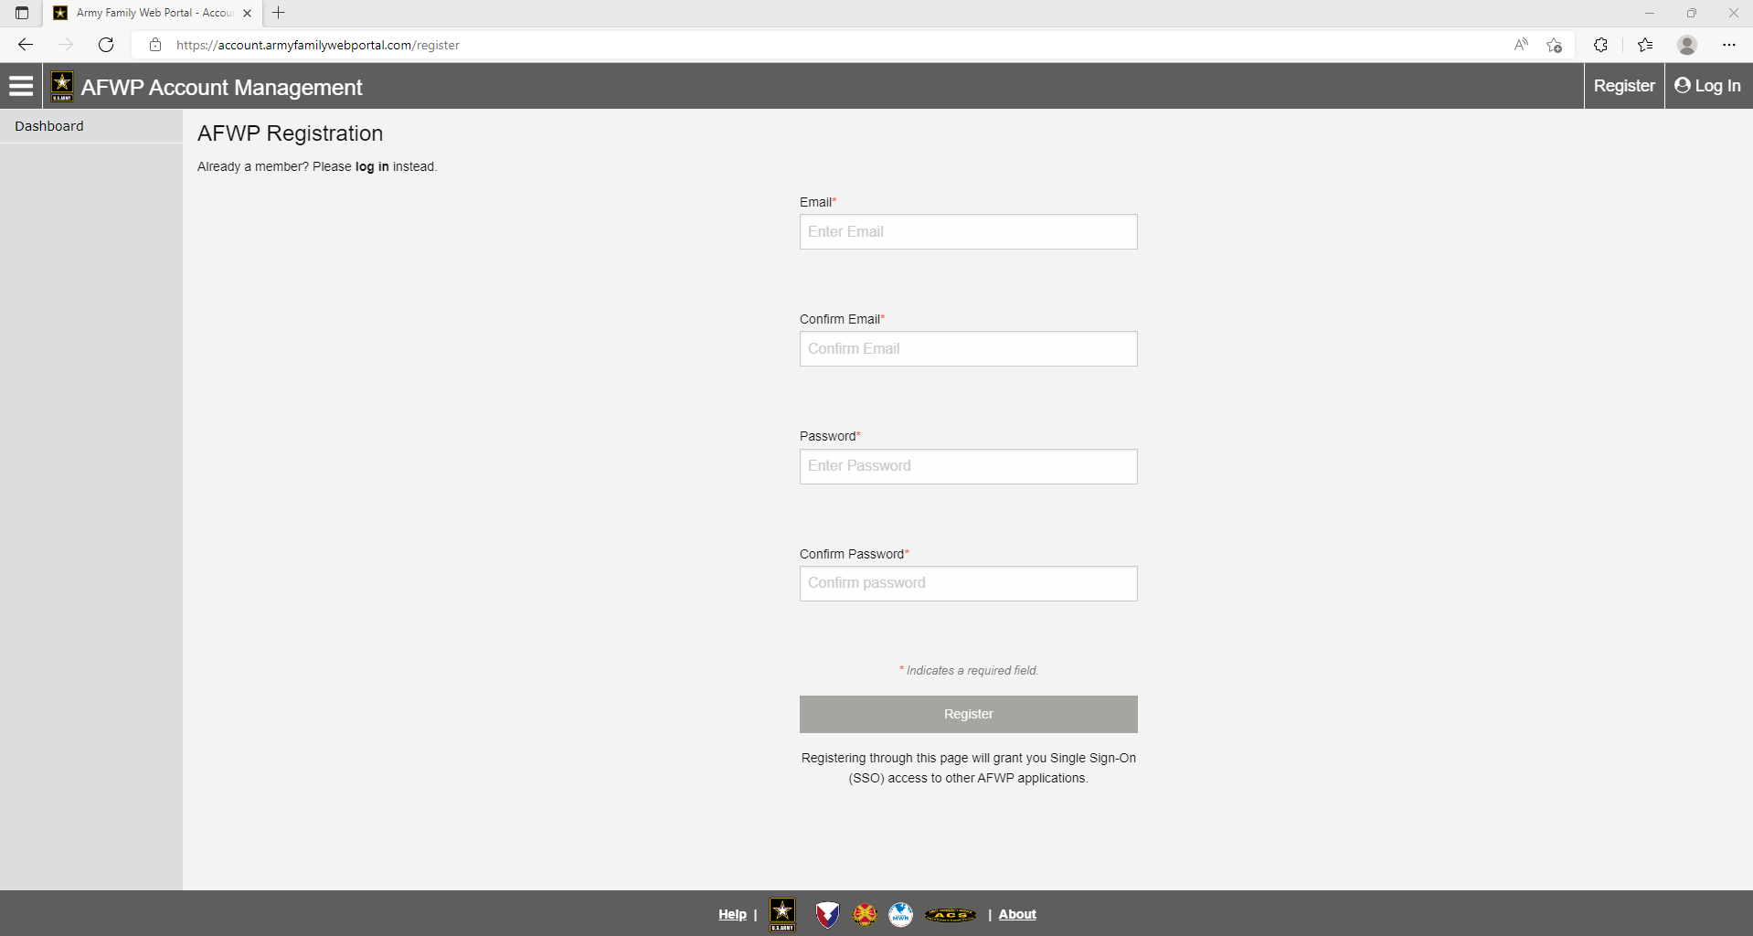
Step 5: You will be routed to this page

Slide 7
Step 6: Click register

Slide 8
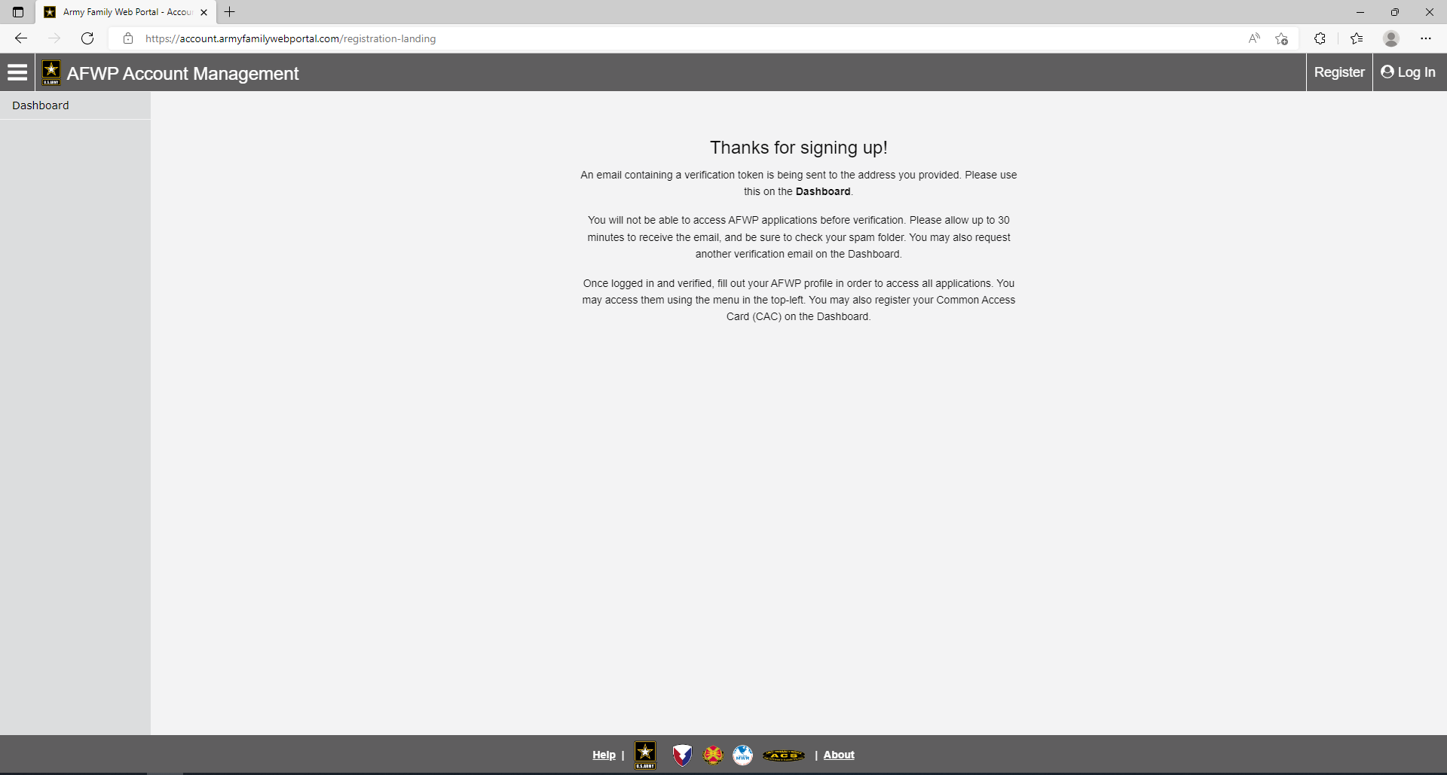
Step 7: Check email used to register for confirmation

Slide 9
Step 8: Click the dashboard tab

Slide 10
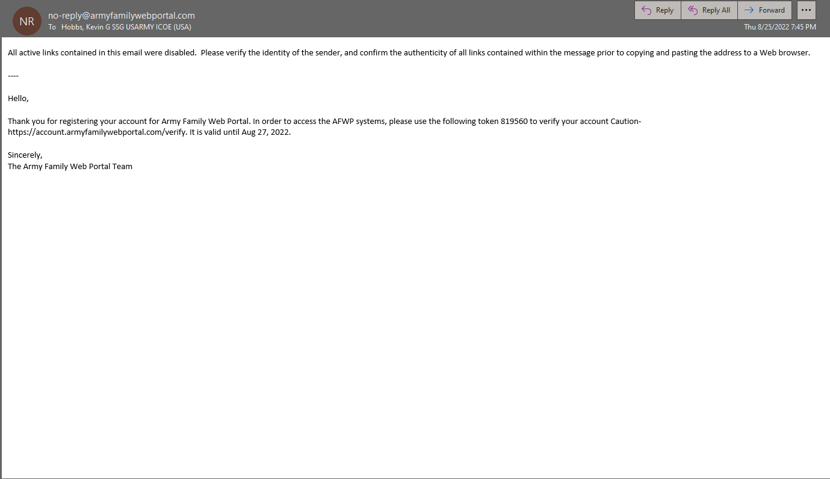
Verification Email should look like this

Slide 11
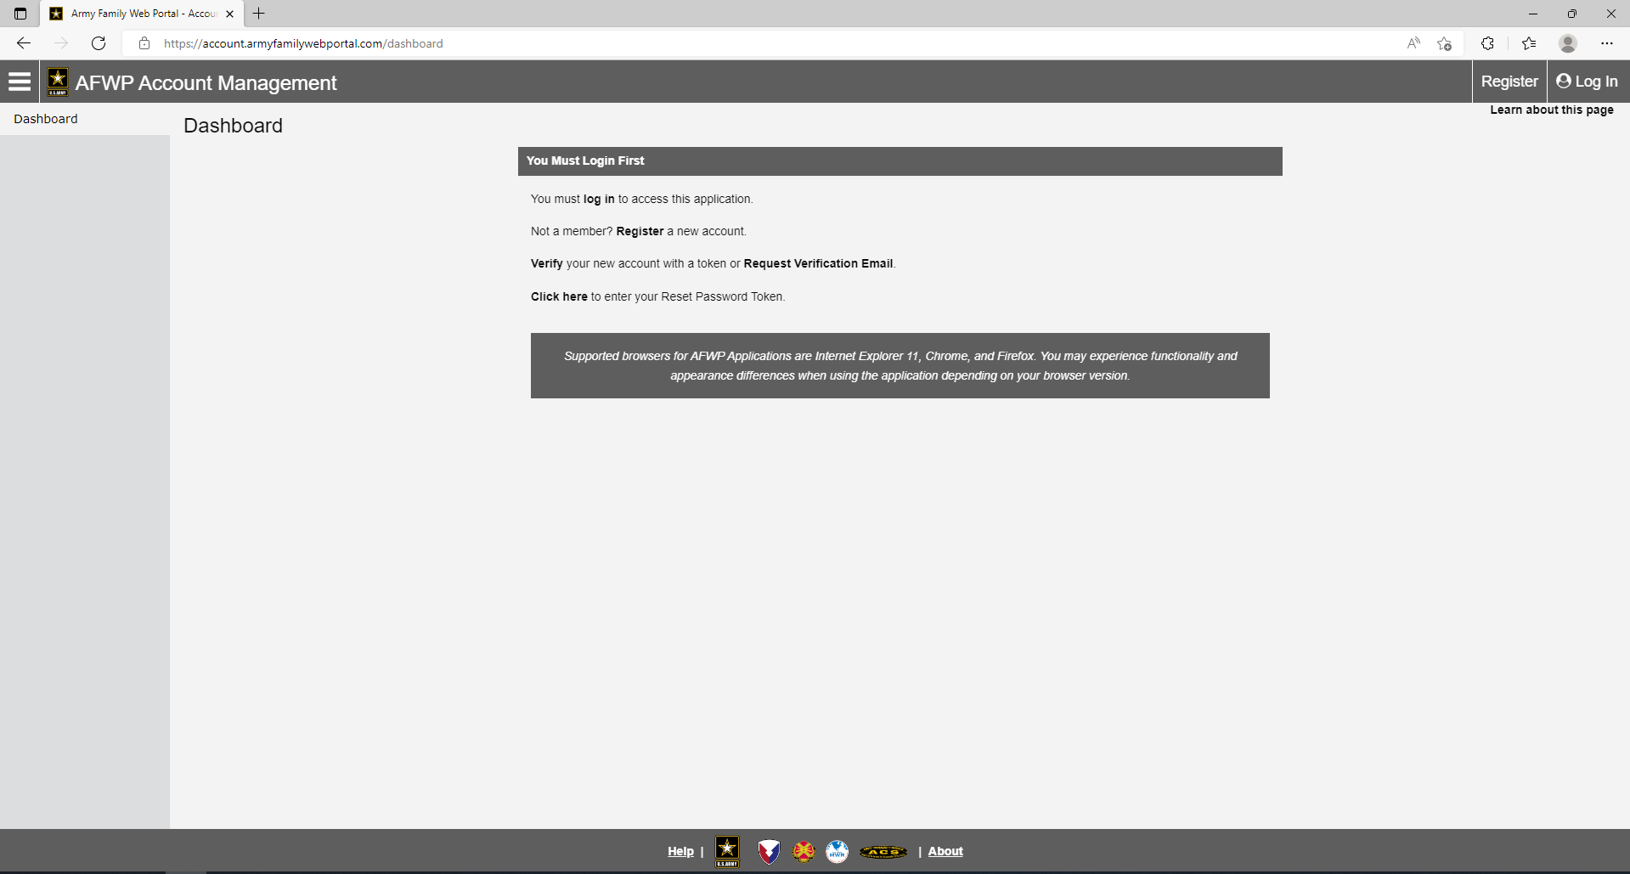
Step 9: After clicking the Dashboard tab you will be routed to this page

Slide 12
Step 10: Click the Verify button

Slide 13
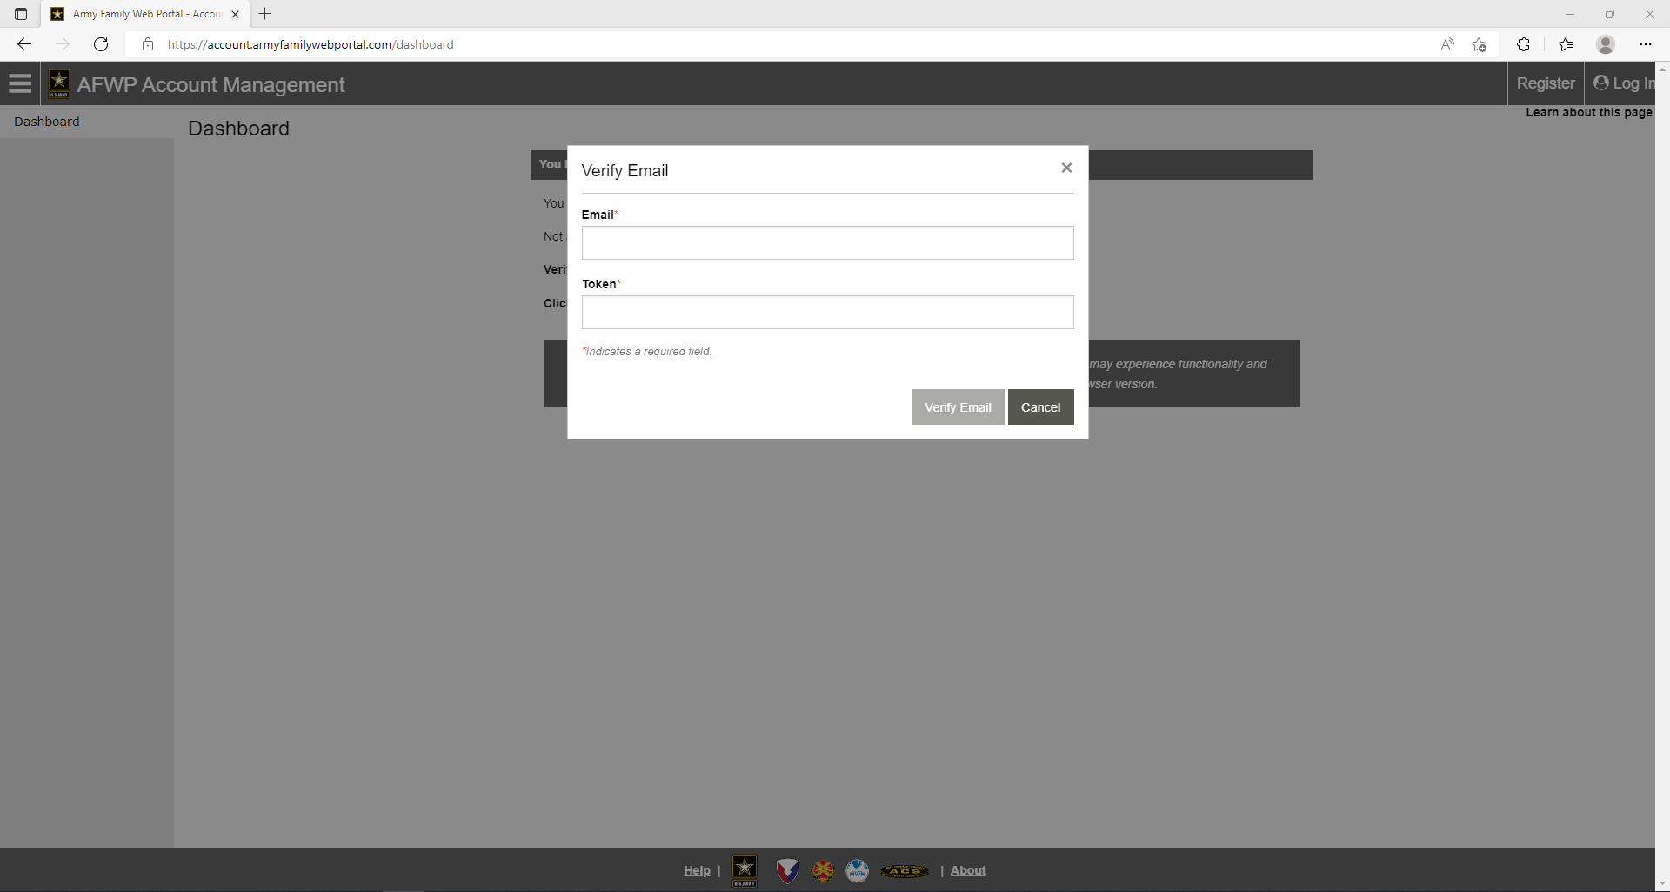
Step 11: The verify Email will pop up put in the email used to register and the token sent to that email

Slide 14
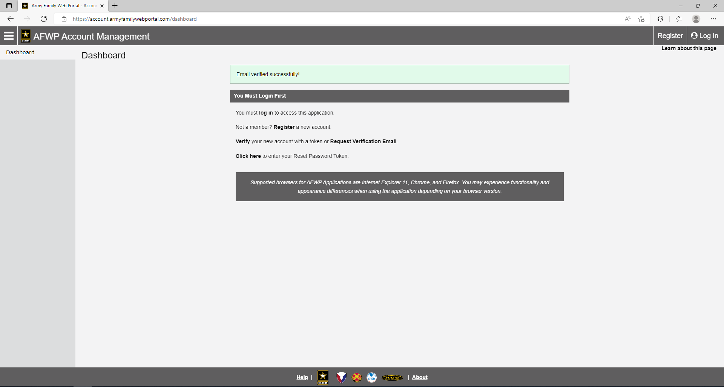
Step 12: After verifying your email you should receive this notification

Slide 15
Step 13: Click “log in”

Slide 16
Step 14: Log in to your account

Slide 17
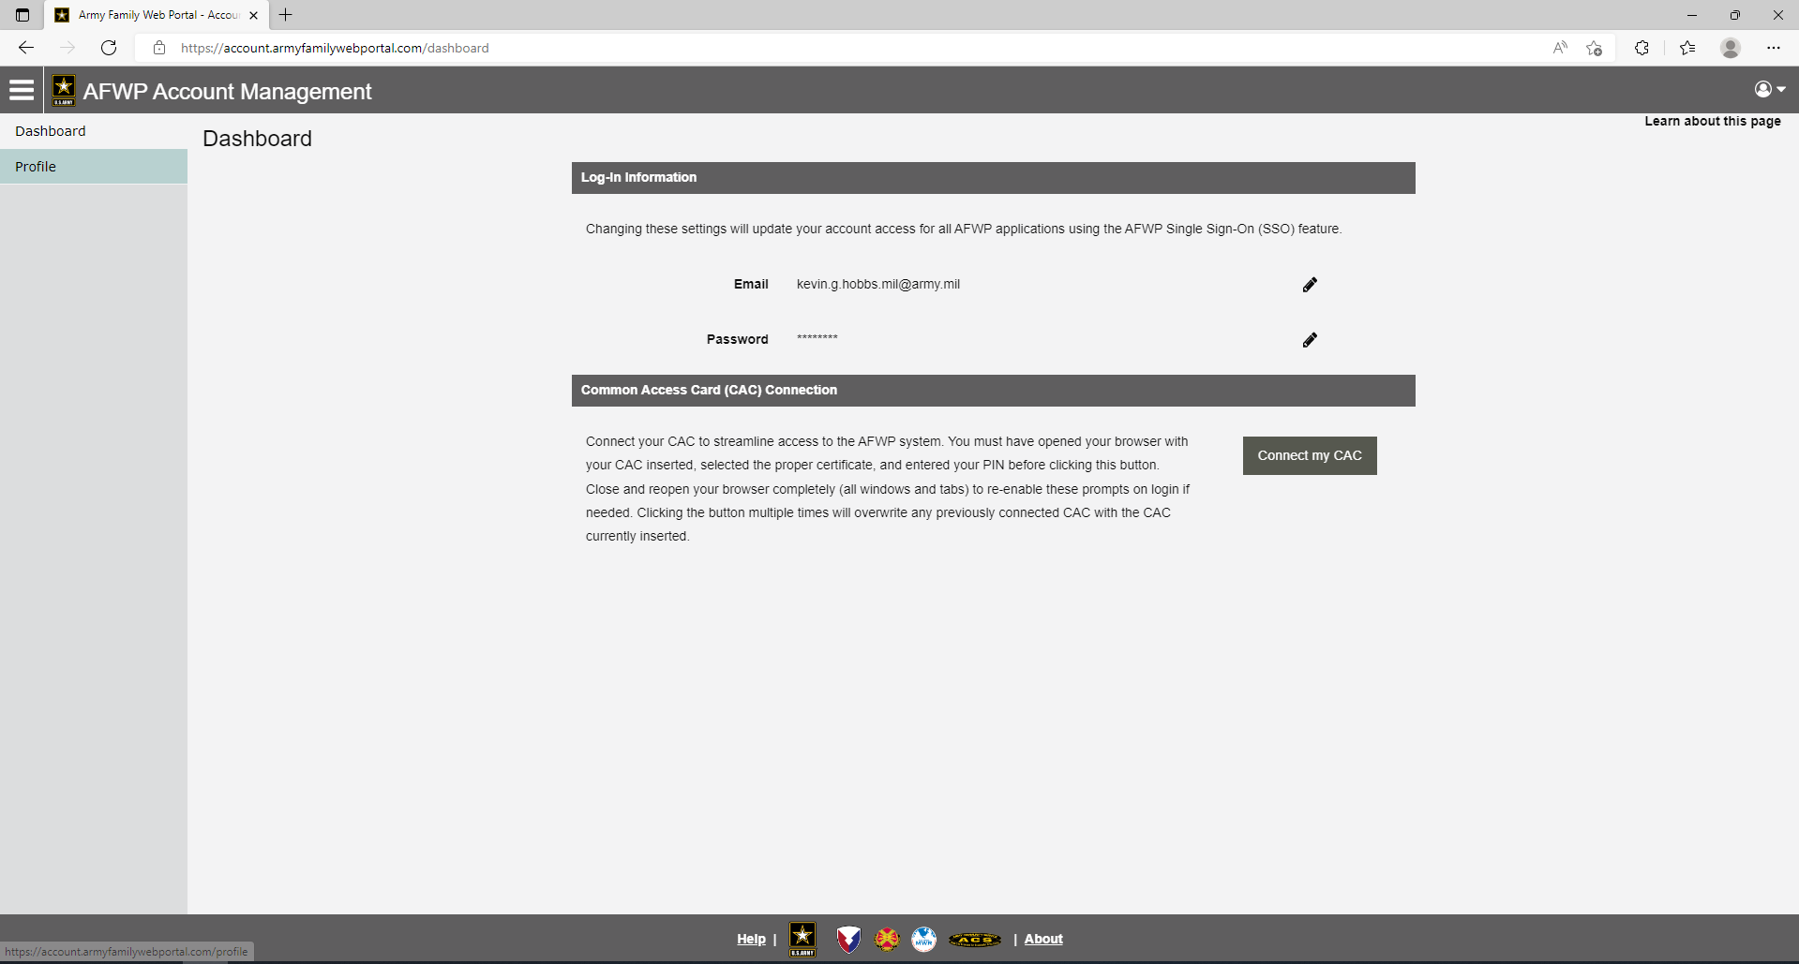
Optional Step: Connecting you CAC

Slide 18
Step 15: Set Up Profile

Slide 19
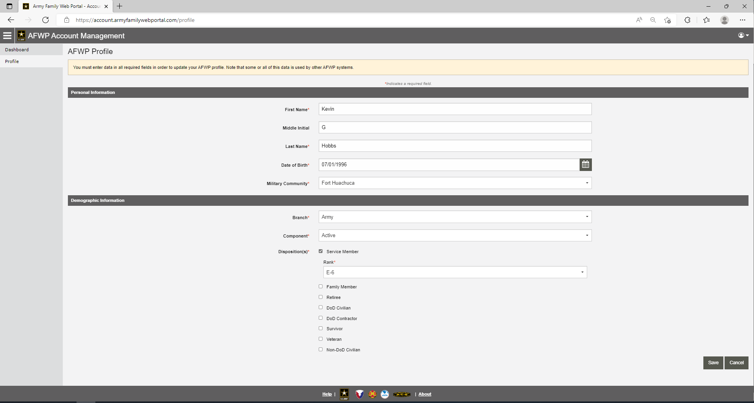
Step 16: Fill out all blocks

Slide 20
Step 17: Save

Slide 21
Step 17: Save

Slide 22
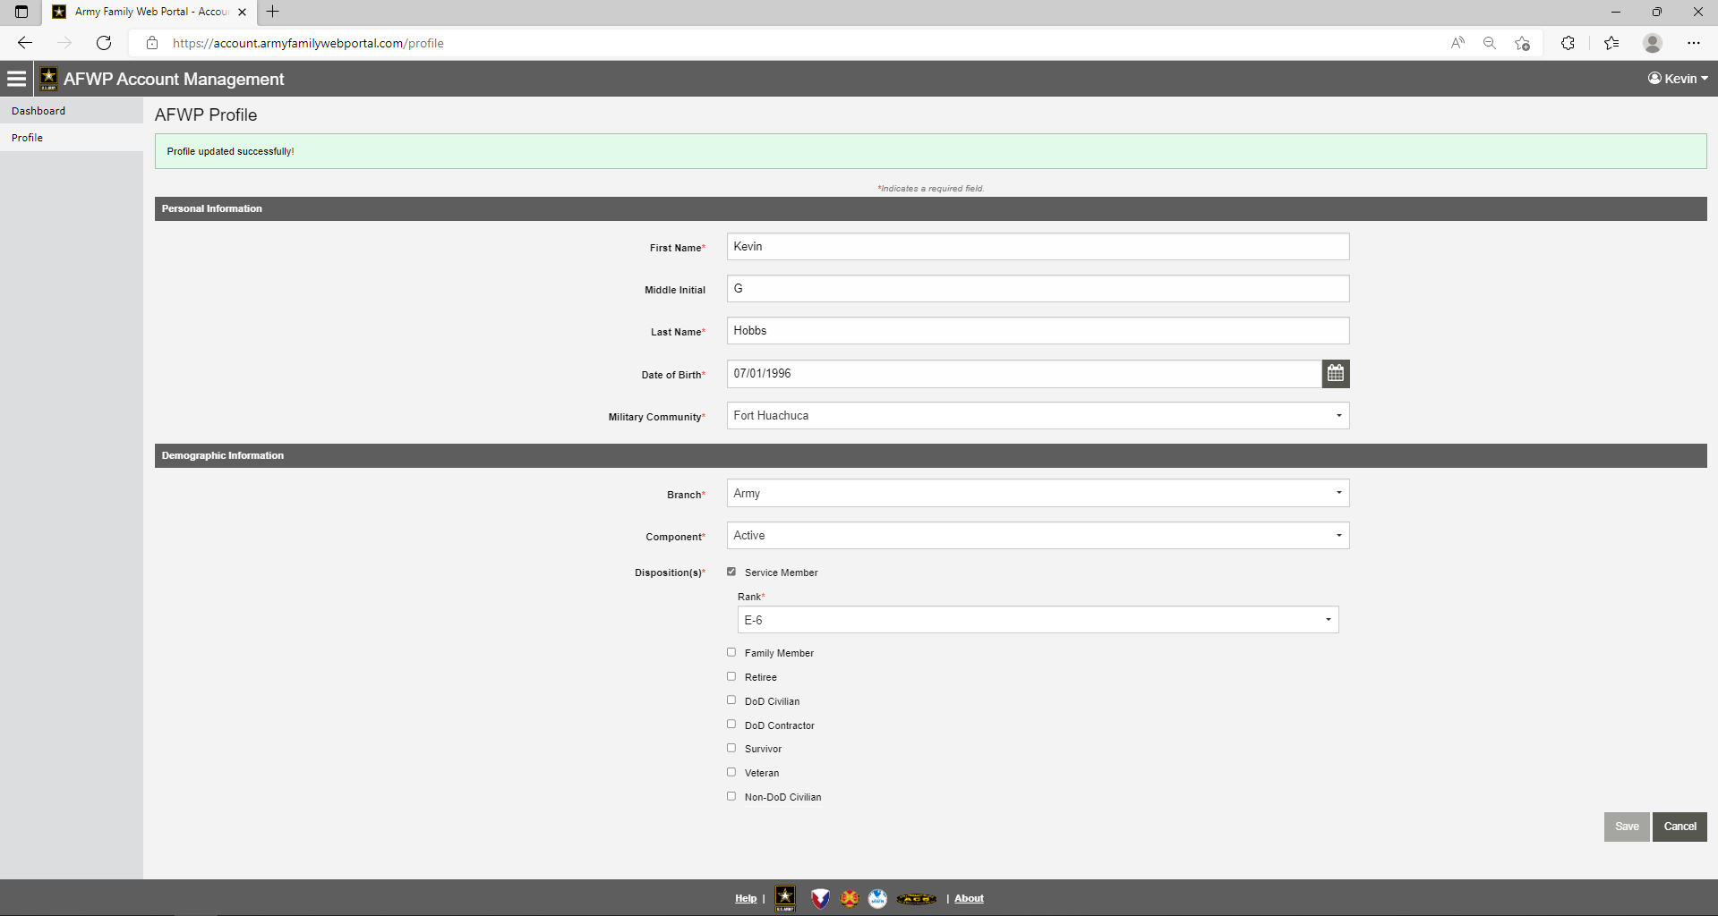
Step 18: You should receive this notification

Slide 23
Step 19: Click the three-line icon in the top right corner

Slide 24
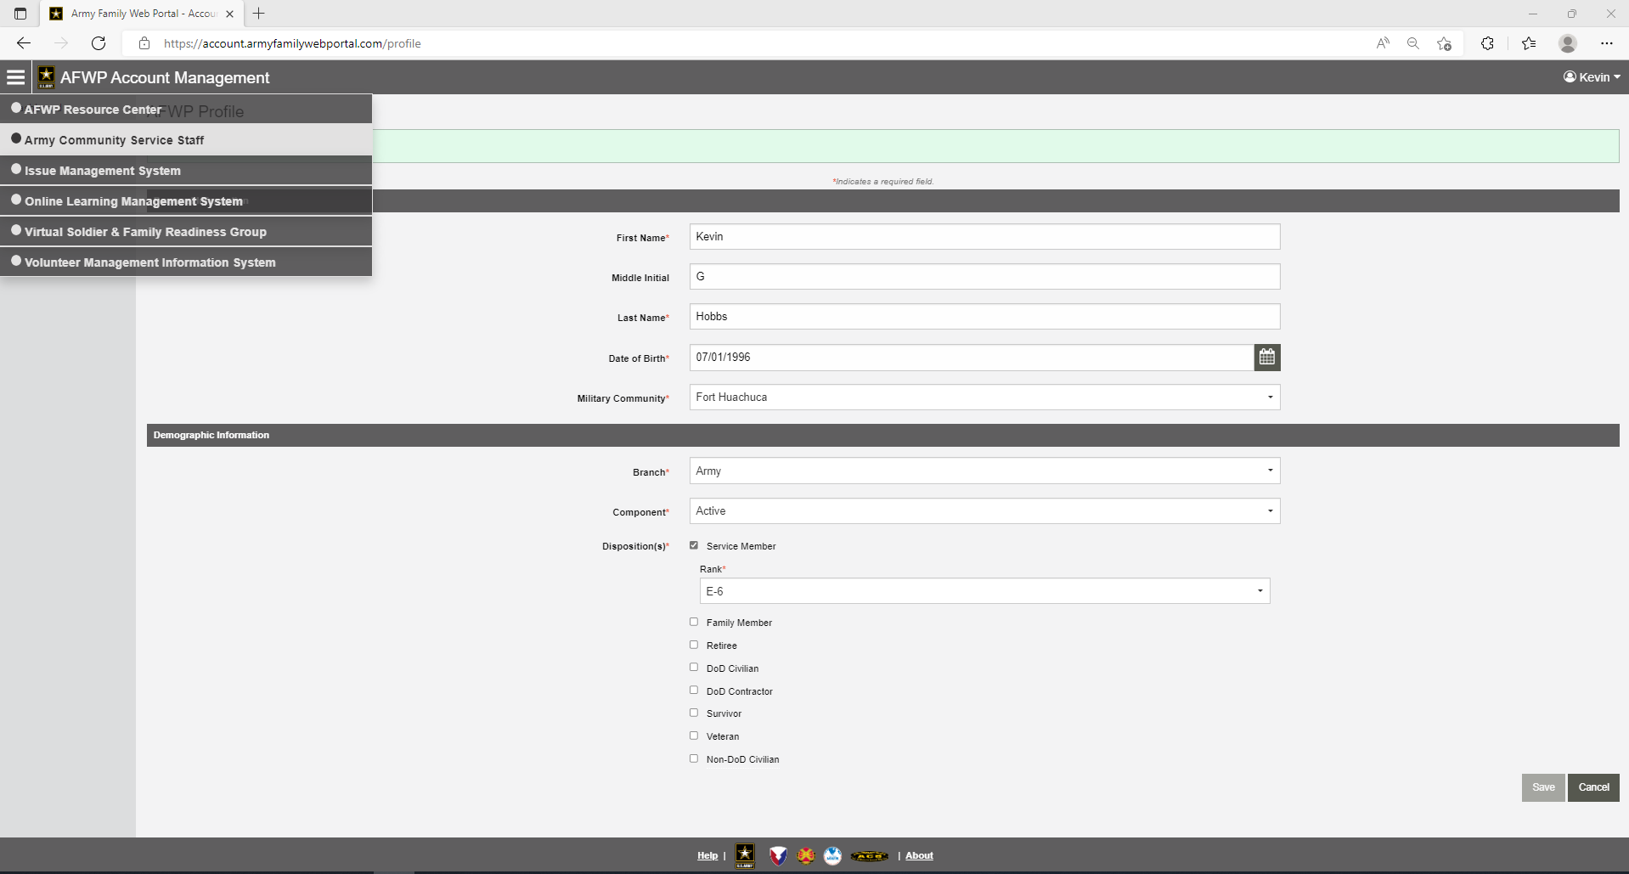
Step 20: Click “Volunteer Management Information System

Slide 25
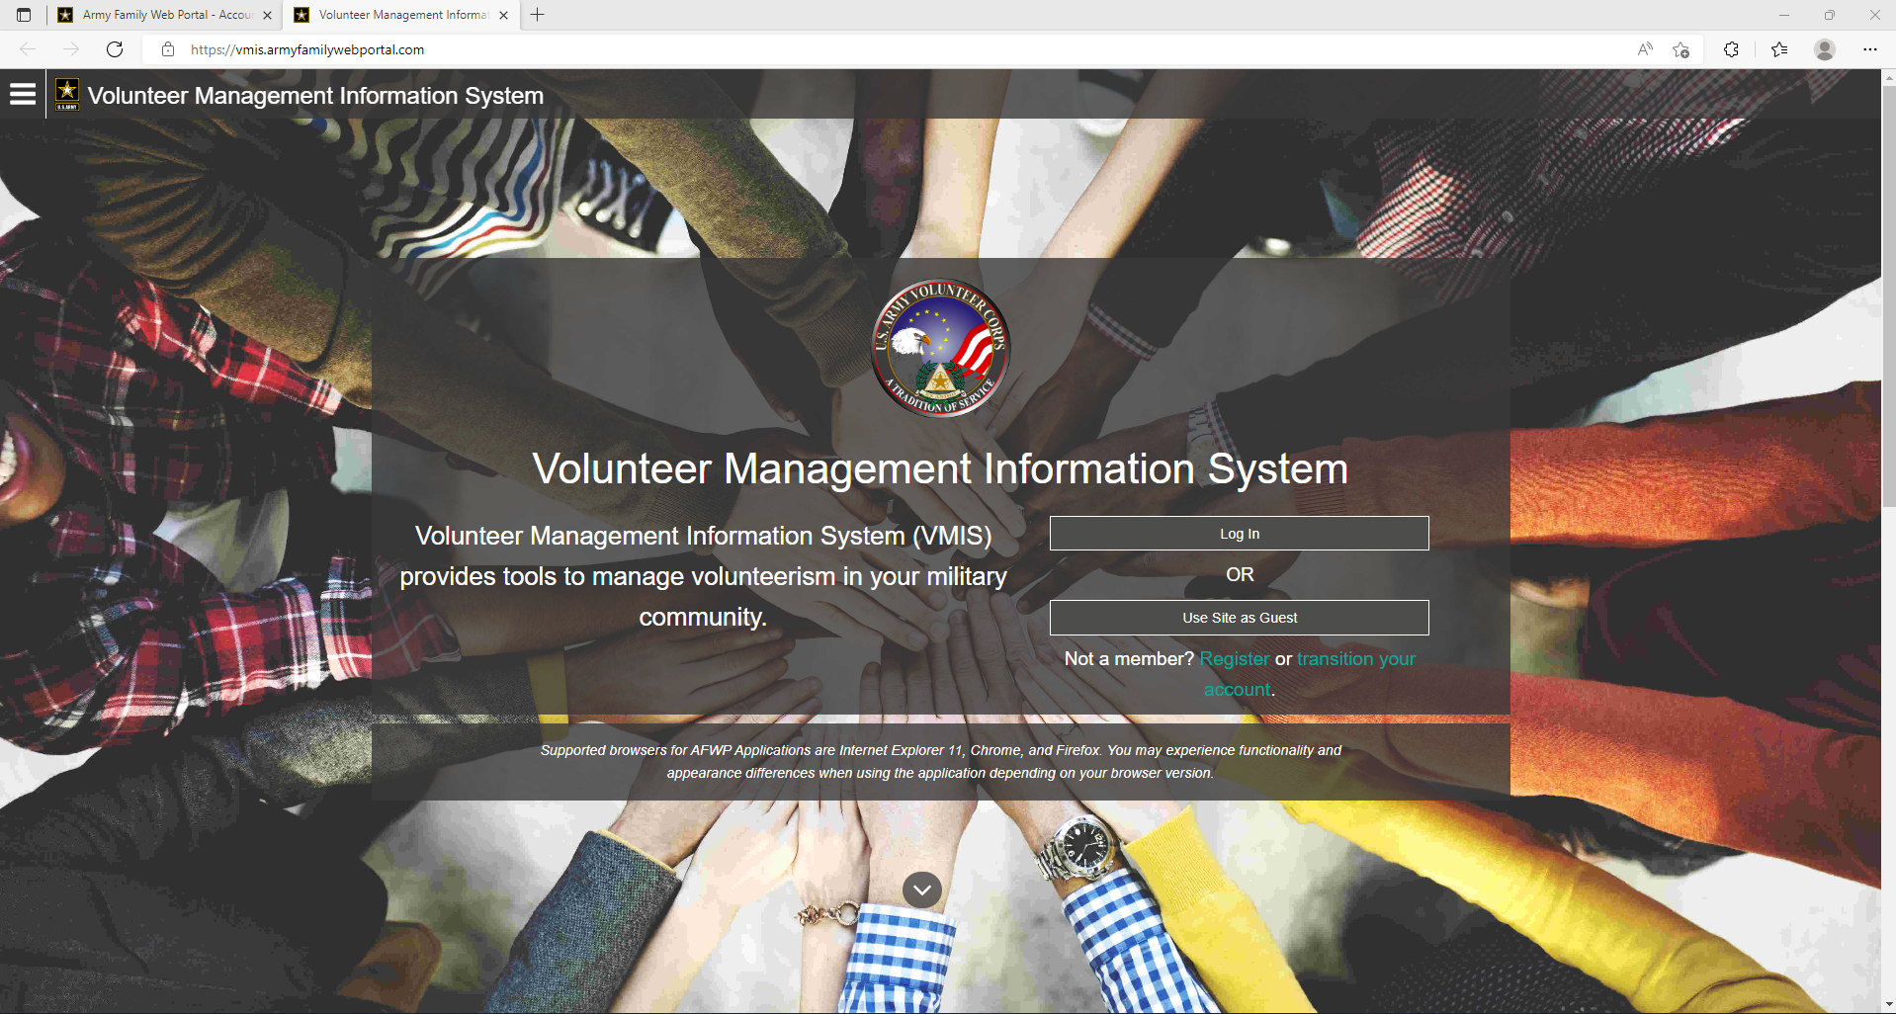
Step 21: You will be routed to this page then click “Log in”

Slide 26
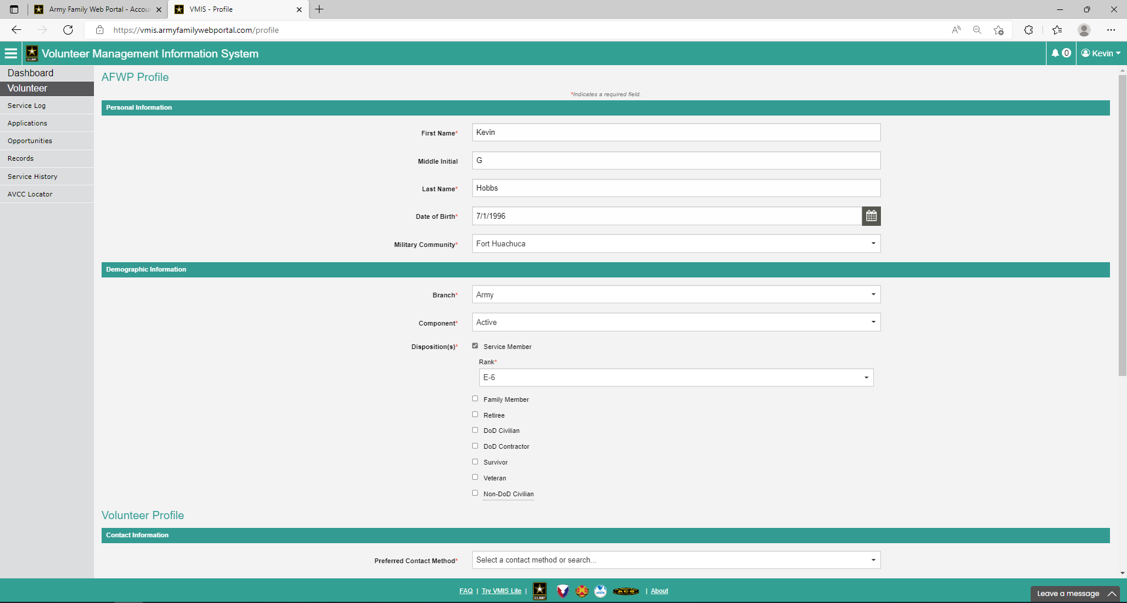
Step 22: You will be routed to this page then here fill out more profile information

Slide 27
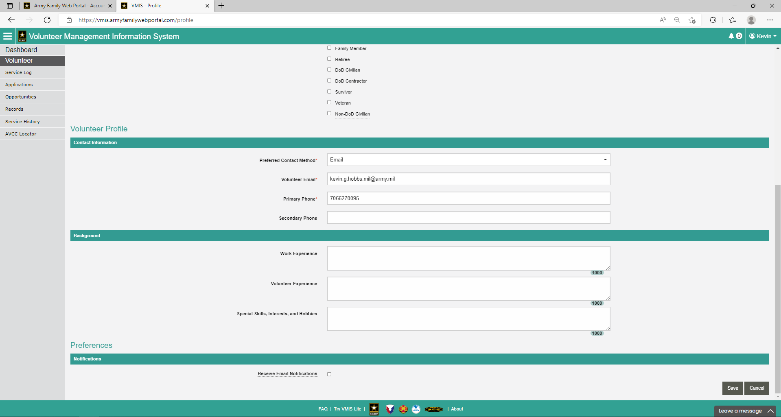
Note you only have to fill out information with a * then click save

Slide 28
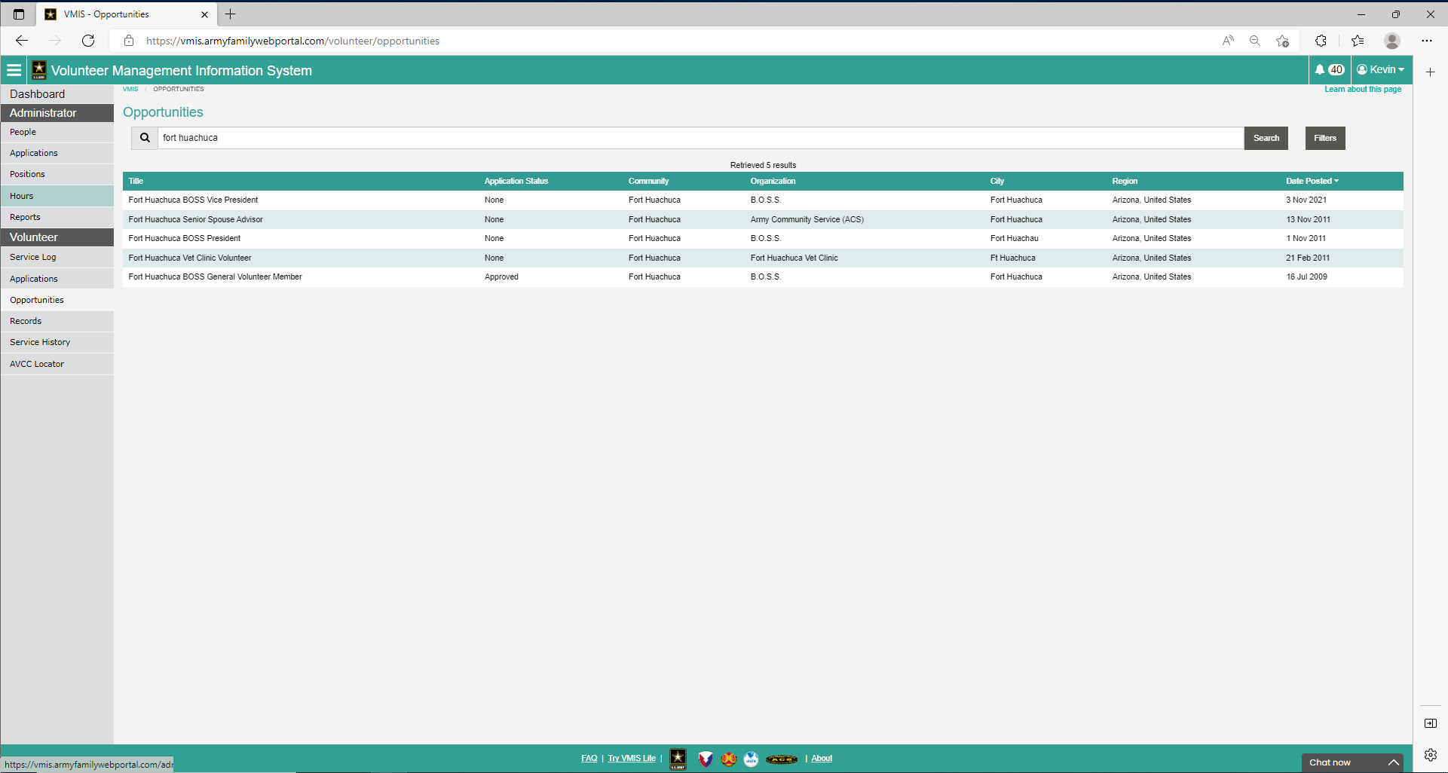
Step 23: Click Opportunities then search “Fort Huachuca” then select “ Fort Huachuca BOSS General Volunteer Member”

Slide 29
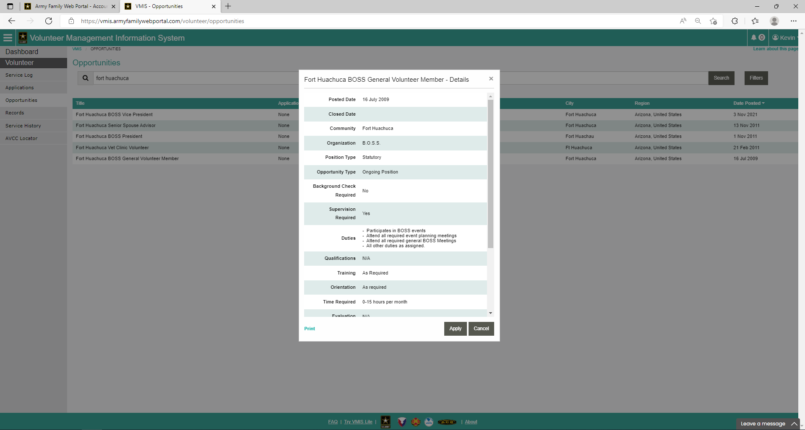
Step 24: Click Apply

Slide 30
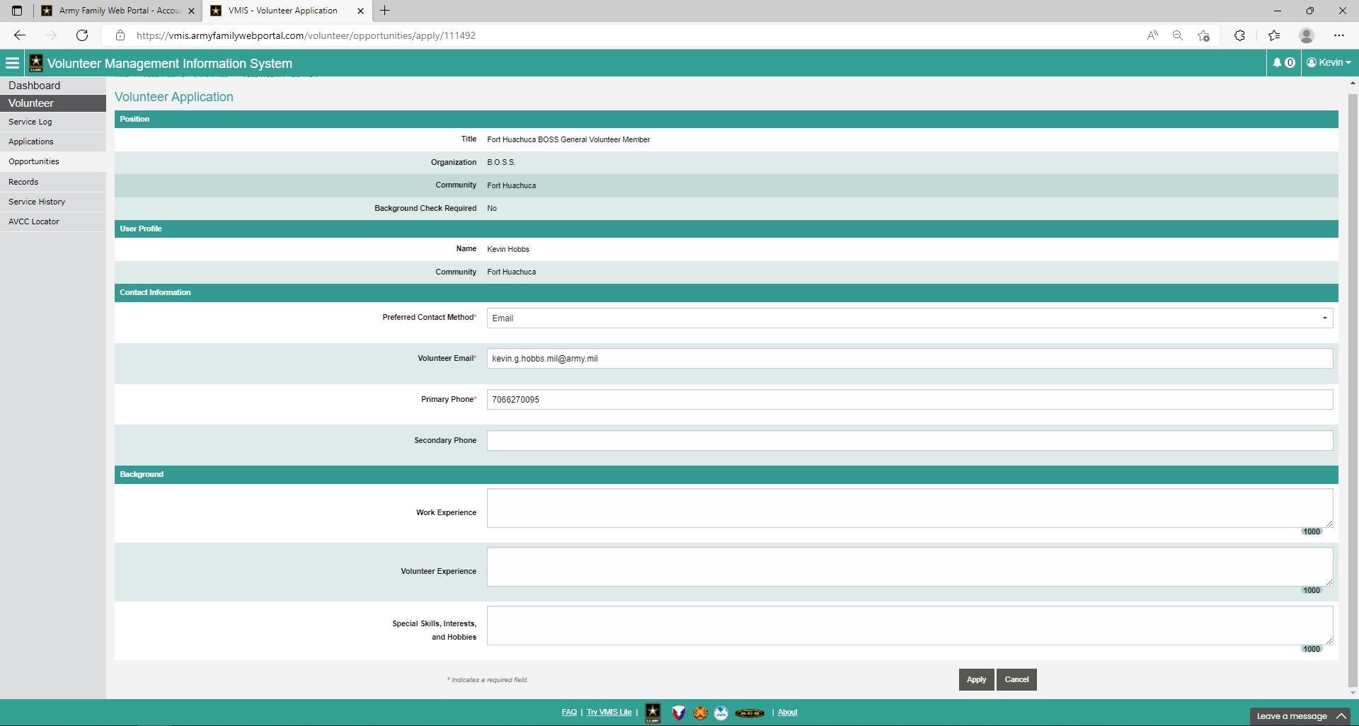
Step 25: Click Apply

Slide 31
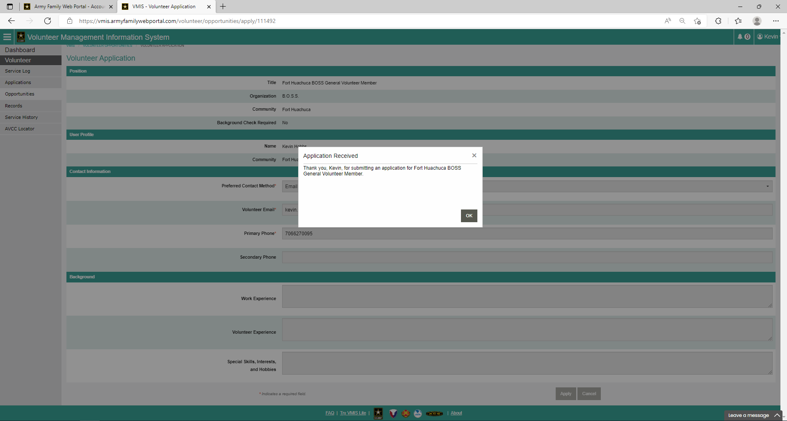
Step 26: Click “OK” and the approving authority will review

